Slide 1


OSI Model & TCP/IP Stack Overview Session No.: 04 Course Name : Fundamentals Of Cyber Security Instructor Name: Duration: 50 minutes Date of Conduction of Class:

Slide 2
Opening Question
When you send a WhatsApp message or open a website, what steps do you think your data goes through before reaching the other person or server?

Slide 3
At the end of this session students will be able to
Learning Outcome 1: Analyze how data flows across different layers of the OSI and TCP/IP models
Learning Outcome 2: Apply the knowledge to diagnose and troubleshoot real-world networking problems.

Slide 4
Session Outline
1 Introduction to OSI Model
2 Seven Layers of OSI Model
3 TCP/IP Protocol Suite
4 Addressing in TCP/IP
5 Comparison of OSI and TCP/IP
6 Applications & Summary

Slide 5
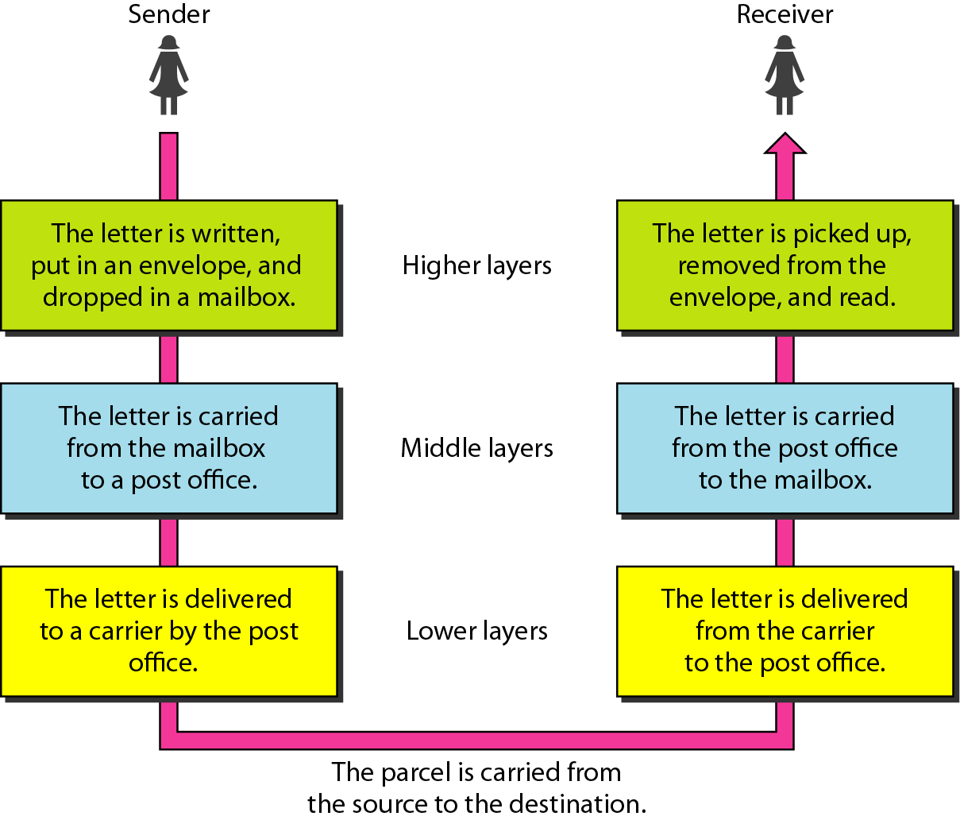
Tasks involved in sending a letter.

Slide 6

THE OSI MODEL
Established in 1947, the International Standards Organization (ISO) is a multinational body dedicated to worldwide agreement on international standards. An ISO standard that covers all aspects of network communications is the Open Systems Interconnection (OSI) model. It was first introduced in the late 1970s.
Note
ISO is the organization. OSI is the model.

Slide 7
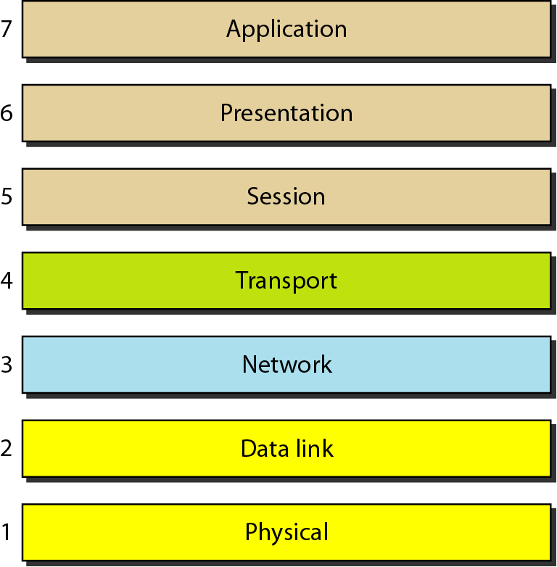
Seven layers of the OSI model

Slide 8
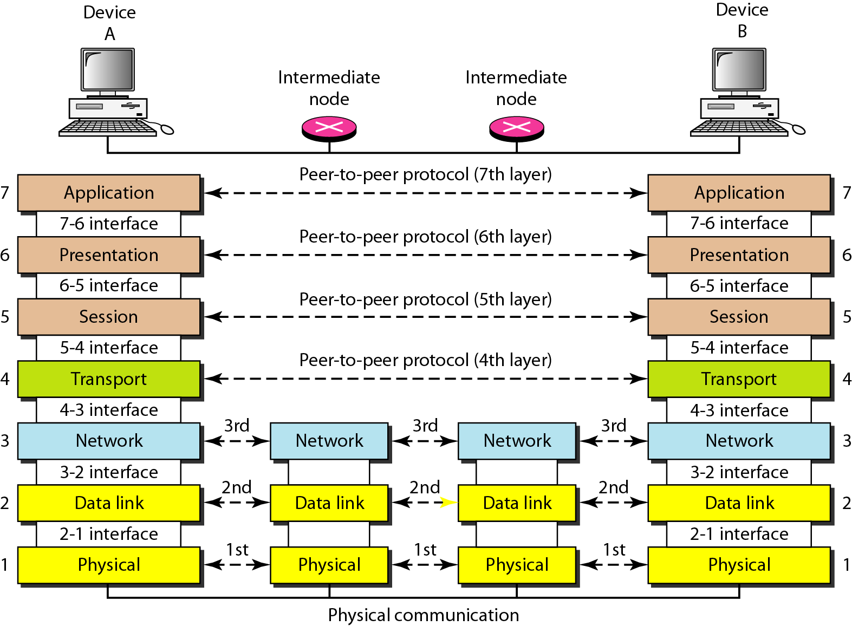
The interaction between layers in the OSI model

Slide 9
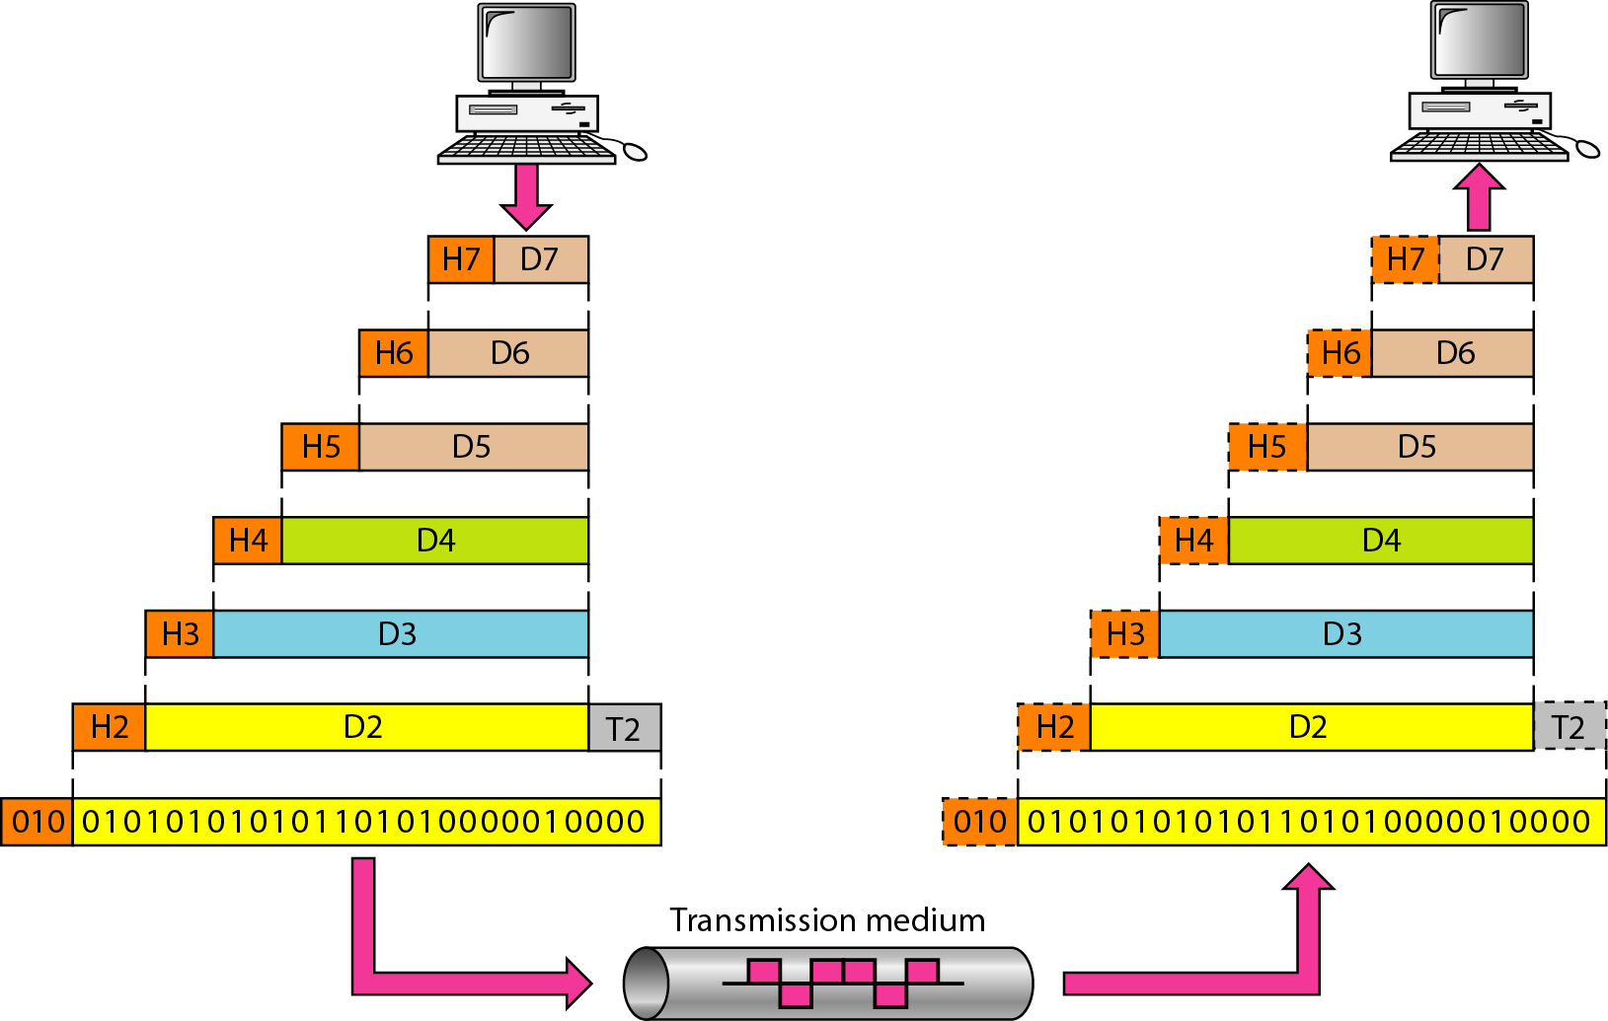
An exchange using the OSI model

Slide 10
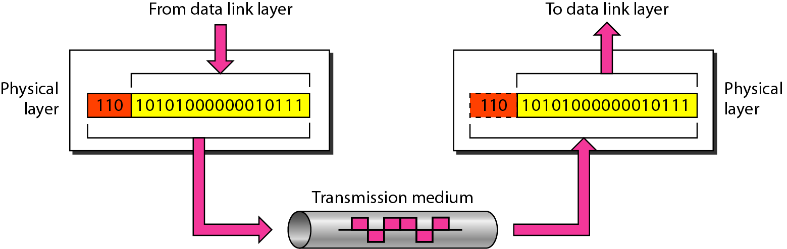
Physical layer
The physical layer is responsible for movements of
individual bits from one hop (node) to the next.

Slide 11
Physical layer
Provides physical interface for transmission of information.
Defines rules by which bits are passed from one system to another on a physical communication medium.
Covers all - mechanical, electrical, functional and procedural - aspects for physical communication.
Such characteristics as voltage levels, timing of voltage changes, physical data rates, maximum transmission distances, physical connectors, and other similar attributes are defined by physical layer specifications.

Slide 12
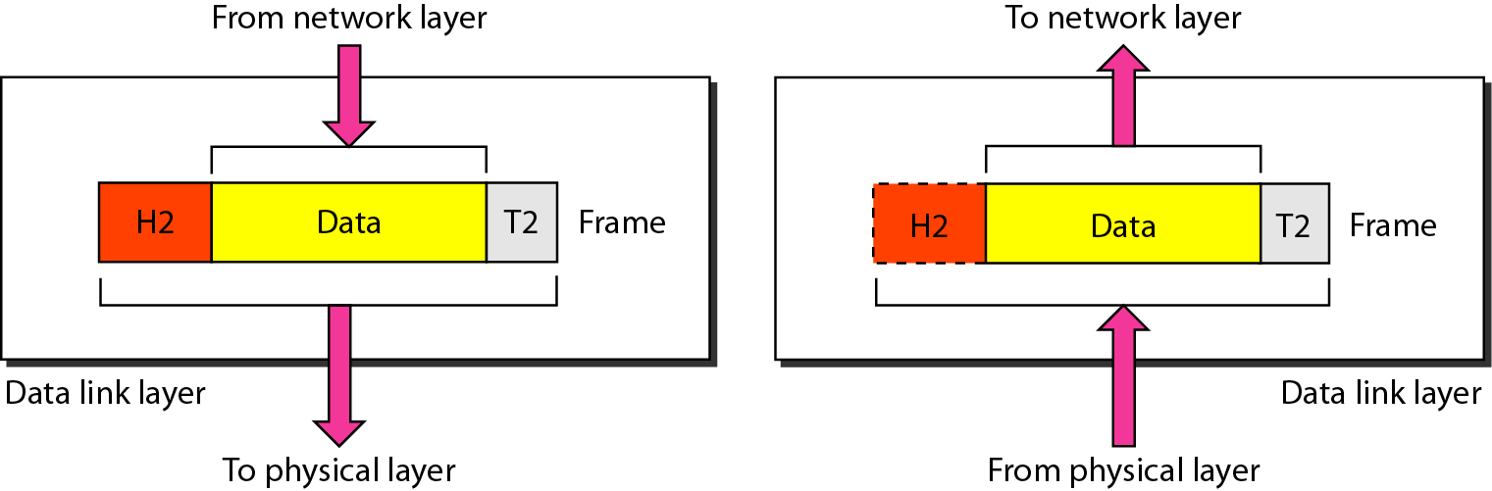
Data link layer
The data link layer is responsible for moving frames from one hop (node) to the next.

Slide 13
Data link layer
Data link layer attempts to provide reliable communication over the physical layer interface.
Breaks the outgoing data into frames and reassemble the received frames.
Create and detect frame boundaries.
Handle errors by implementing an acknowledgement and retransmission scheme.
Implement flow control.
Supports points-to-point as well as broadcast communication.
Supports simplex, half-duplex or full-duplex communication.

Slide 14
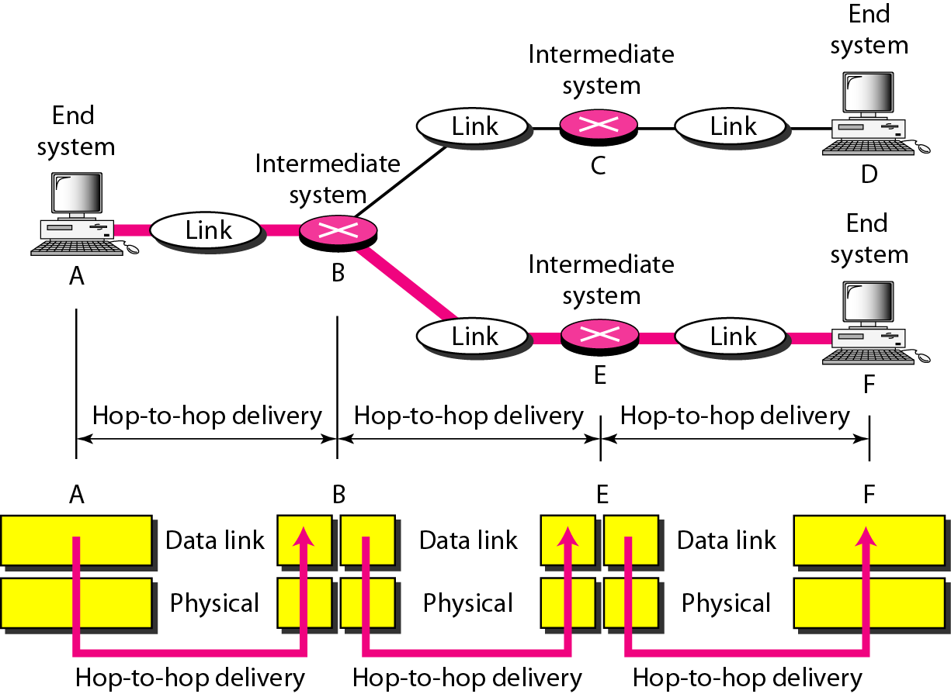
Hop-to-hop delivery

Slide 15
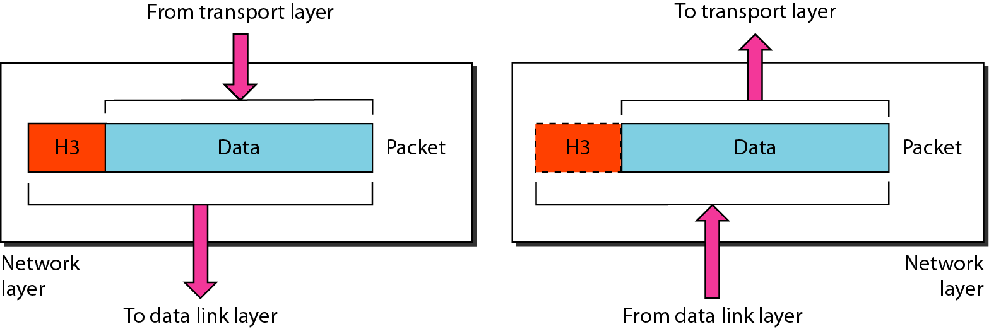
Network layer
The network layer is responsible for the delivery of individual packets from
the source host to the destination host.

Slide 16
Network layer
Implements routing of frames (packets) through the network.
Defines the most optimum path the packet should take from the source to the destination
Defines logical addressing so that any endpoint can be identified.
Handles congestion in the network.
Facilitates interconnection between heterogeneous networks (Internetworking).
The network layer also defines how to fragment a packet into smaller packets to accommodate different media.

Slide 17
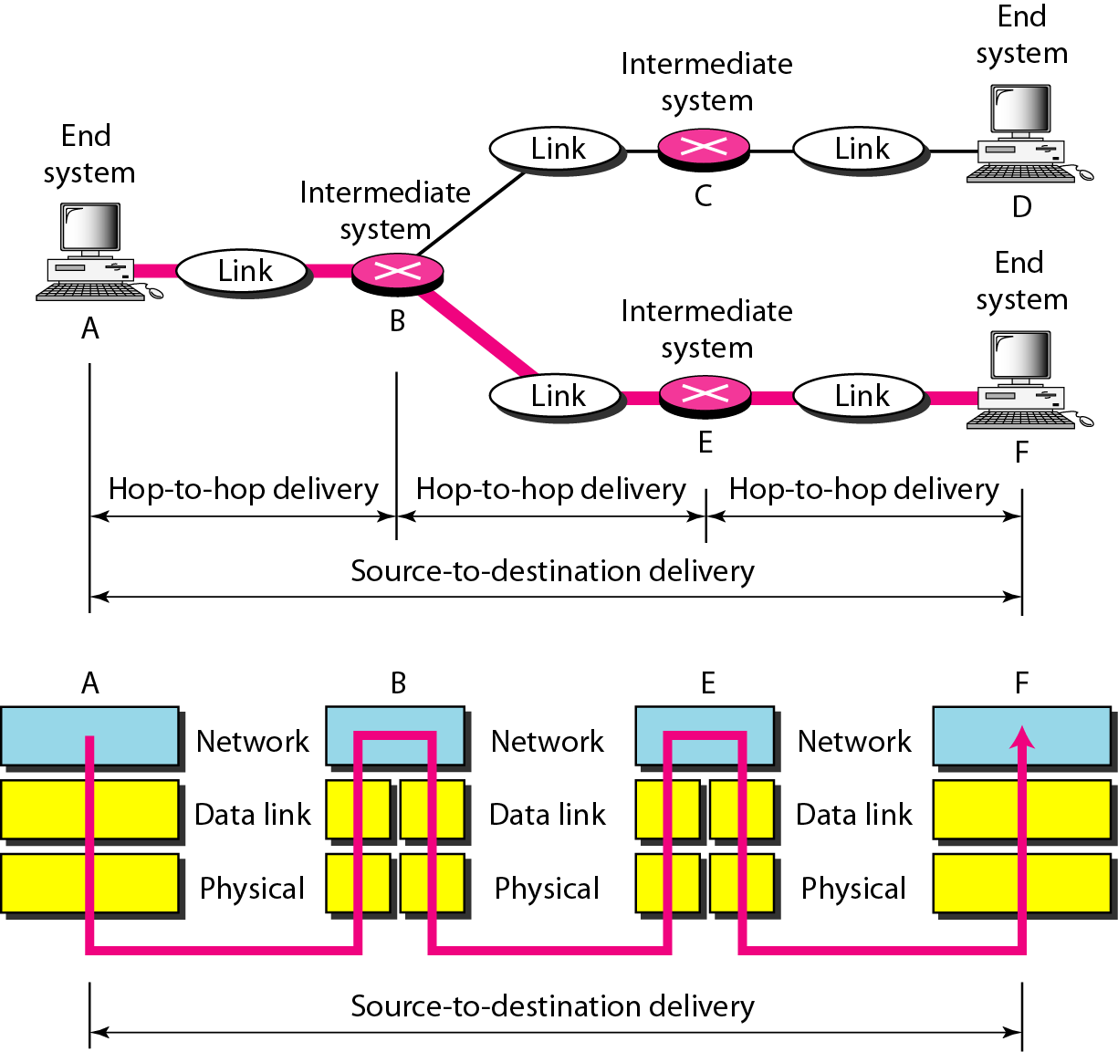
Source-to-destination delivery

Slide 18
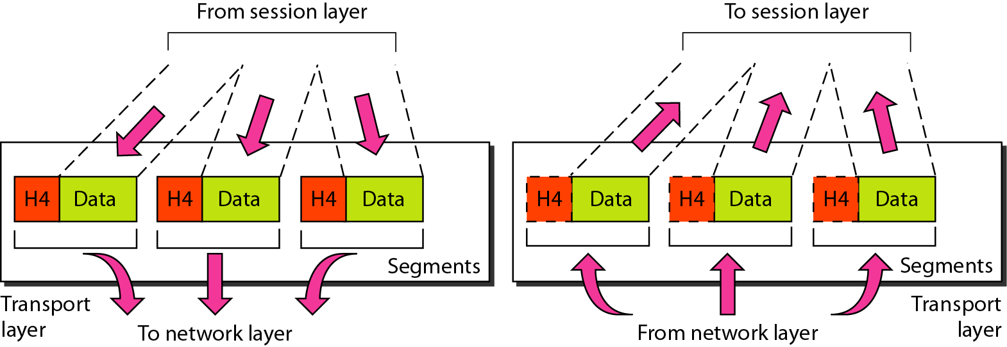
Transport layer
The transport layer is responsible for the delivery of a message from one process to another.

Slide 19
Transport layer
Purpose of this layer is to provide a reliable mechanism for the exchange of data between two processes in different computers.
Ensures that the data units are delivered error free.
Ensures that data units are delivered in sequence.
Ensures that there is no loss or duplication of data units.
Provides connectionless or connection oriented service.
Provides for the connection management.
Multiplex multiple connection over a single channel.

Slide 20
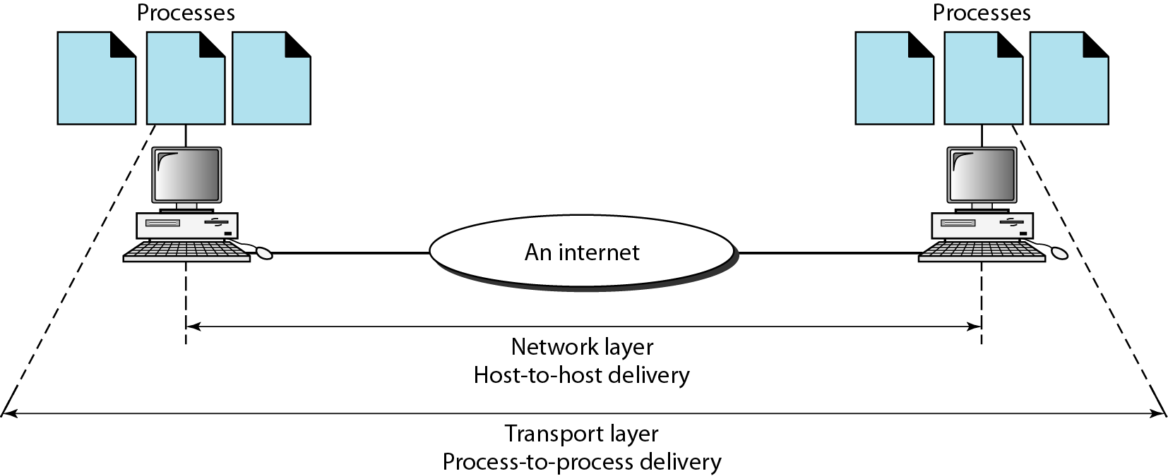
Reliable process-to-process delivery of a message

Slide 21
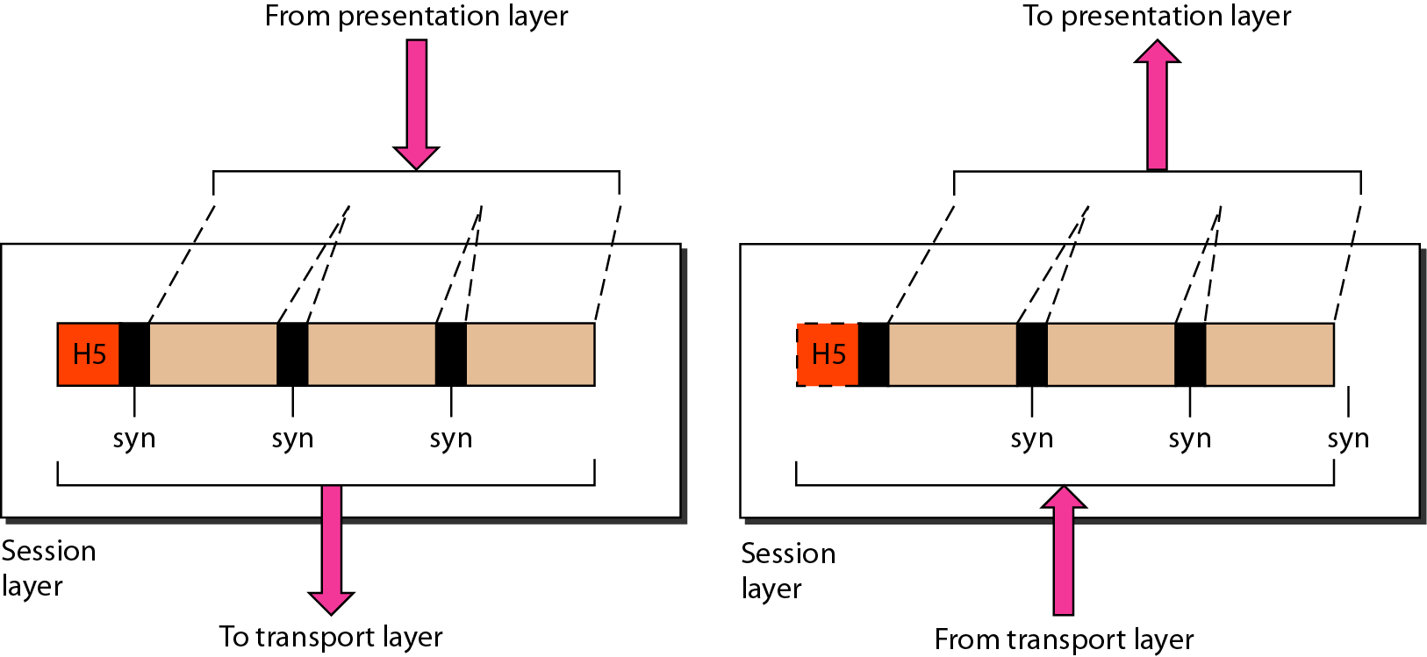
Session layer
The session layer is responsible for dialog control and synchronization.

Slide 22
Session layer
Session layer provides mechanism for controlling the dialogue between the two end systems. It defines how to start, control and end conversations (called sessions) between applications.
This layer requests for a logical connection to be established on an end-user’s request.
Any necessary log-on or password validation is also handled by this layer.
Session layer is also responsible for terminating the connection.
This layer provides services like dialogue discipline which can be full duplex or half duplex.
Session layer can also provide check-pointing mechanism such that if a failure of some sort occurs between checkpoints, all data can be retransmitted from the last checkpoint.

Slide 23
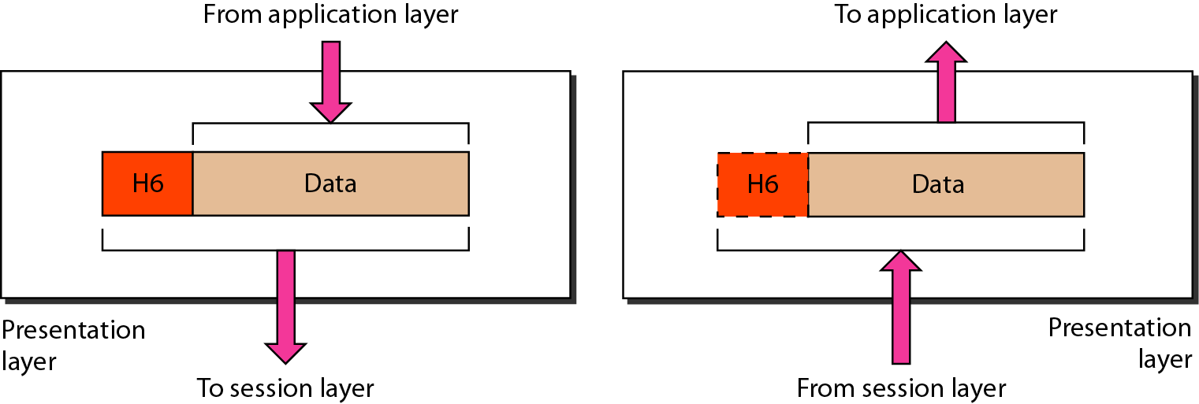
Presentation layer
The presentation layer is responsible for translation, compression, and encryption.

Slide 24
Presentation layer
Presentation layer defines the format in which the data is to be exchanged between the two communicating entities.
Also handles data compression and data encryption (cryptography).

Slide 25
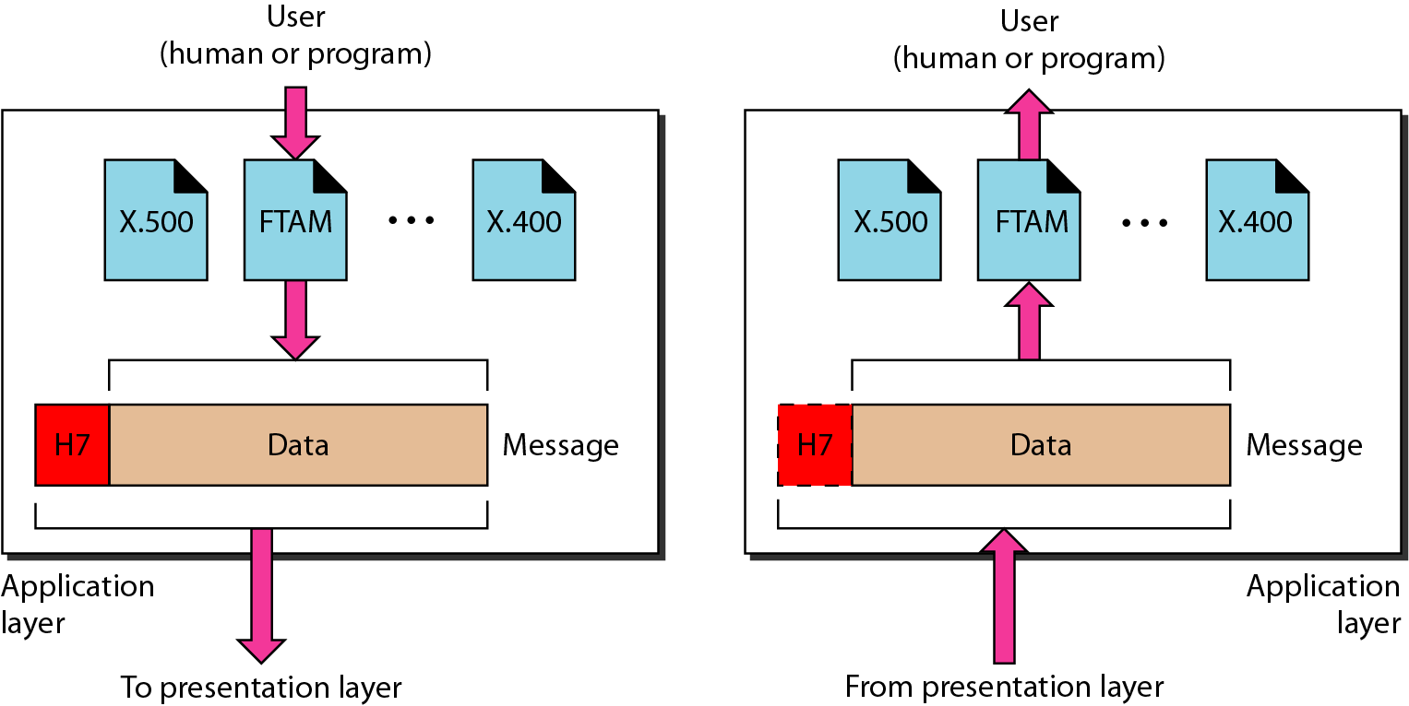
Application layer
The application layer is responsible for providing services to the user.

Slide 26
Application layer
Application layer interacts with application programs and is the highest level of OSI model.
Application layer contains management functions to support distributed applications.
Examples of application layer are applications such as file transfer, electronic mail, remote login etc.

Slide 27
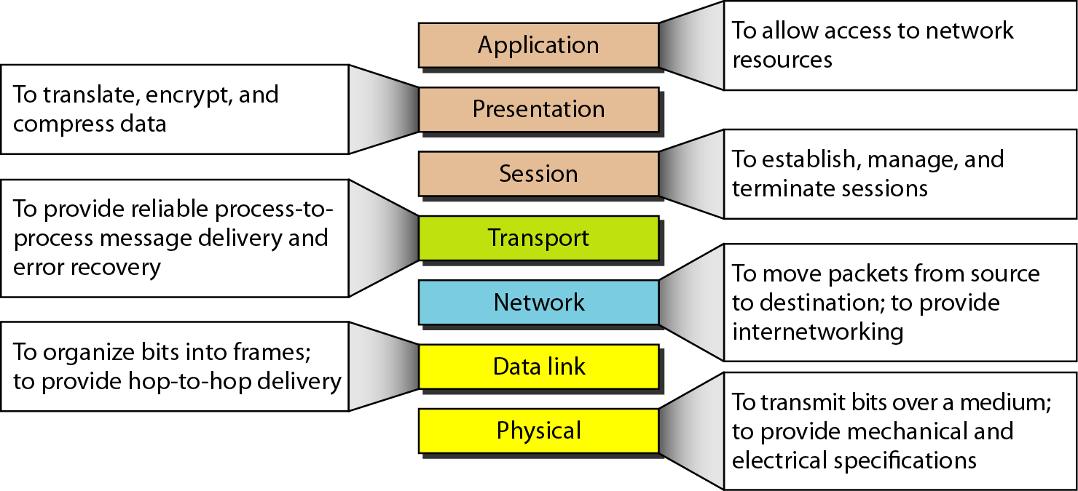
Summary of layers

Slide 28
Activity 1 – Think Share Pair
Break into group of two.
Each group is given a real-world communication scenario, such as:
Encryption (TLS), compression
Composing the email / web browser / app
IP addressing and routing
Maintaining login session
TCP ensures reliable delivery
Actual transmission via cables or radio waves
Ethernet/Wi-Fi handling frames
Map them with the responsibility of respective layers
.

Slide 29
TCP/IP PROTOCOL SUITE
The layers in the TCP/IP protocol suite do not exactly match those in the OSI model.
The original TCP/IP protocol suite was defined as having four layers: host-to-network, internet, transport, and application.
However, when TCP/IP is compared to OSI, we can say that the TCP/IP protocol suite is made of five layers:
Physical
Data link
Network
Transport
Application.

Slide 30
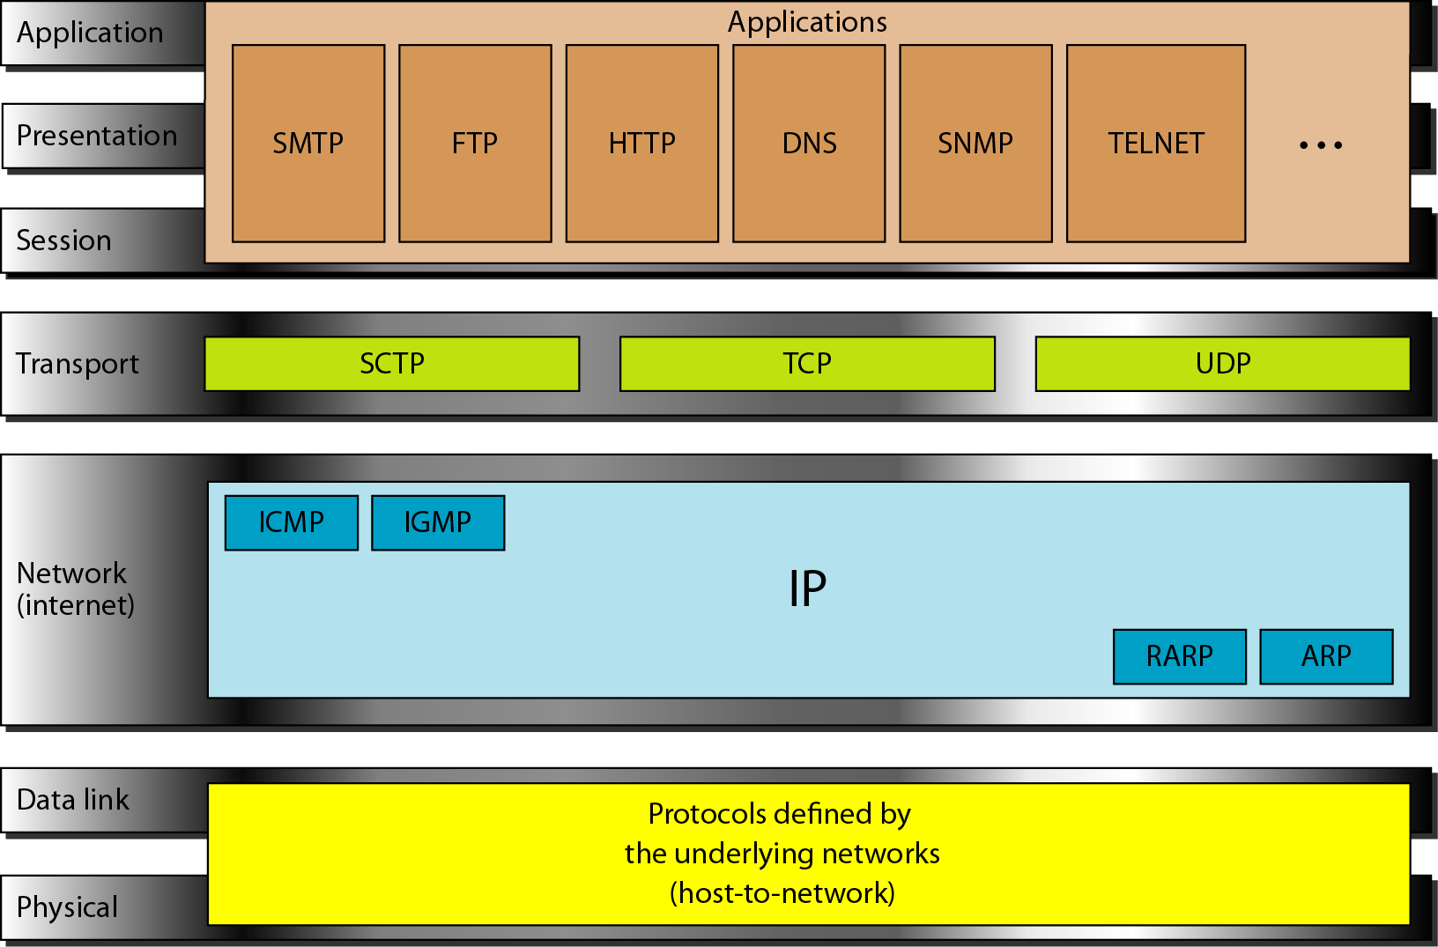
TCP/IP PROTOCOL SUITE

Slide 31
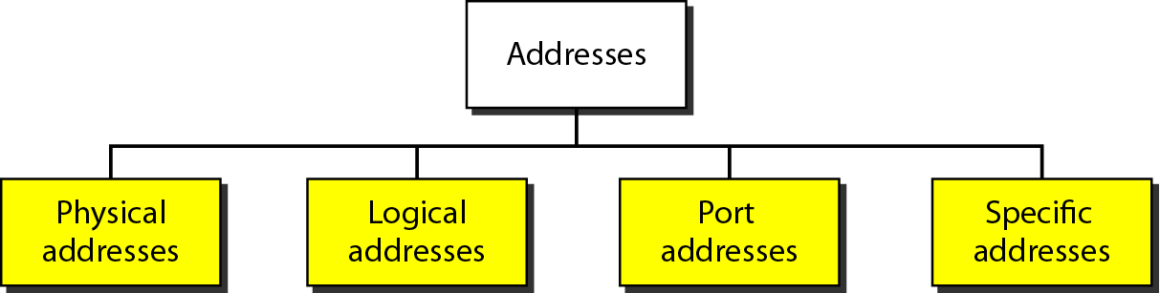
ADDRESSING
Four levels of addresses are used in an internet employing the TCP/IP protocols: physical, logical, port, and specific.

Slide 32
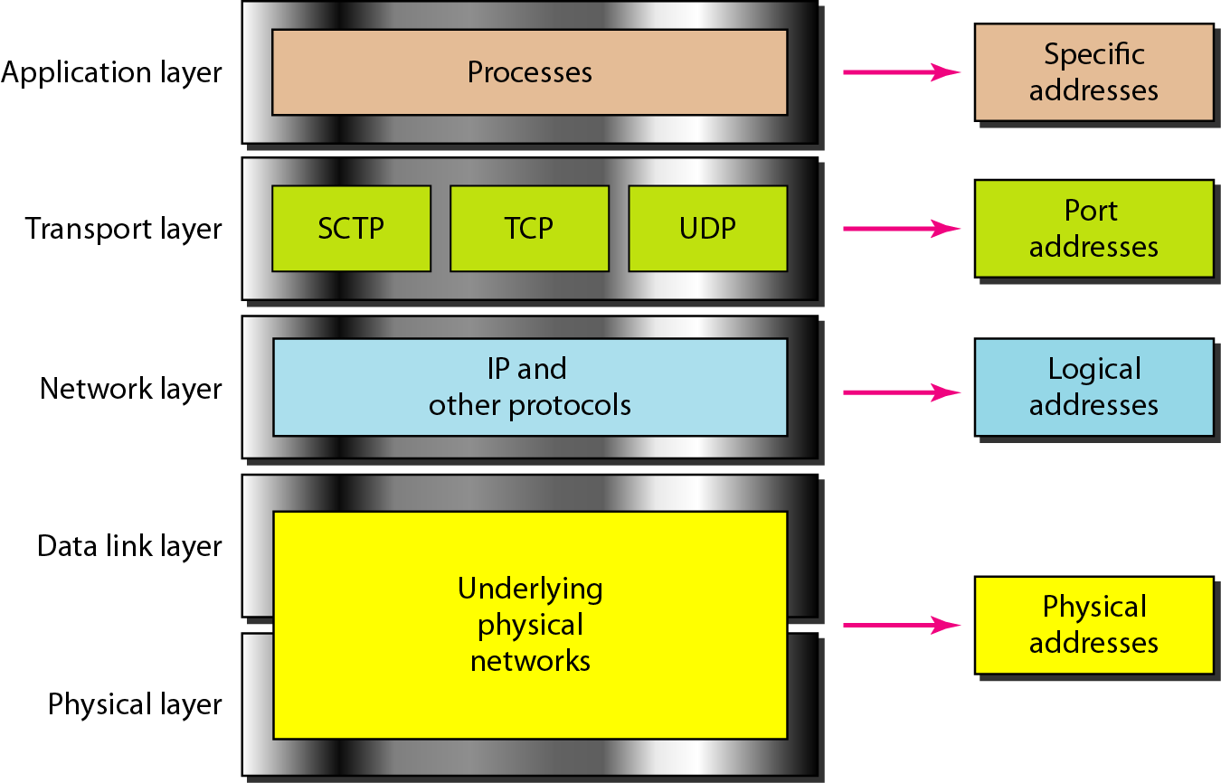
Relationship of layers and addresses in TCP/IP

Slide 33
Comparison of the OSI and TCP/IP Reference Models
Functionality of the layers is roughly similar
Concepts central to OSI model
Services : The service definition tells what the layer does, not how entities above it access it . It defines the layer's semantics.
Interfaces : tells the processes above it how to access it. It specifies what the parameters are and what results to expect.
Protocols: the layer's own business.

Slide 34
Comparison of the OSI and TCP/IP Reference Models
OSI reference model was devised before the corresponding protocols were invented. This ordering means that the model was not biased toward one particular set of protocols.
The protocols came first, and the model was really just a description of the existing protocols.
Number of layers: the OSI model has seven layers and the TCP/IP has four layers.
The TCP/IP model has only one mode in the network layer (connectionless) but supports both modes in the transport layer.

Slide 35
Closing Questions
Why do you think the TCP/IP model is more widely used in real-world networking compared to the OSI model?
How does the transport layer of TCP/IP ensure reliable communication over an unreliable network?

Slide 36
Ensure attainment of LOs in alignment to the learning activities:
Learning Outcome 1: Analyze how data flows across different layers of the OSI and TCP/IP models
Learning Outcome 2: Apply the knowldge to diagnose and troubleshoot real-world networking problems.

Slide 37
UPCOMING SESSION
In the next session, students will explore Operating System and Web Basics for Security

Slide 38
THANK YOU !

